Slide 1
Final year project presentation
Presented by Emmett Byrne

Slide 2
Introduction
I want to investigate a Neural networks ability to complete a simple 2D maze
What makes this more relevant to Neural networks rather than a pathfinding Algorithm is that the network will have limited information on its surroundings

Slide 3
Why is this relevant
Advanced AI and neural networks will have a huge impact in the future
Examples:
Google's self driving cars
Speech recognition for call centres
Facial recognition for security

Slide 4
The maze
2D grid of tiles
There will be randomly generated walls throughout the maze
The maze has multiple difficulty levels with the amount of walls dependant on the difficulty level of the maze.
Specifically each tile will have 3% * (difficulty level) chance of being a wall.

Slide 5
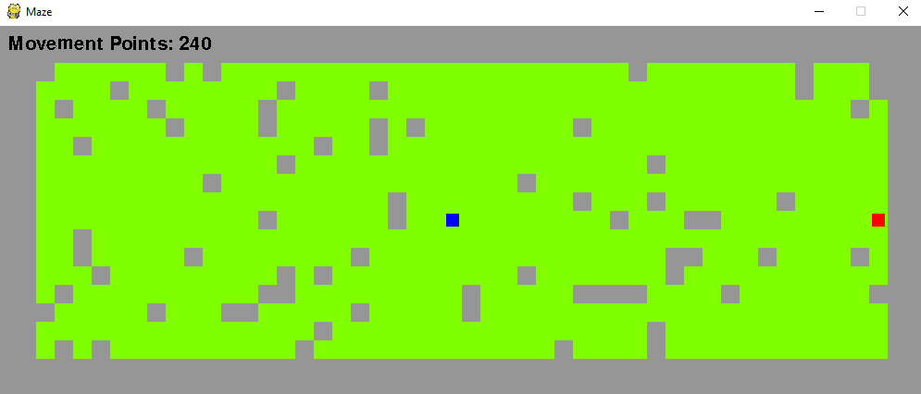

The maze
Player starts at the left hand side
Goal is on the right hand side
The neural network Can only see tiles within 2 moves of its position

Slide 6
OpenNN
Initial neural network library
Uses c++
Managed to get examples running.
Learning the library was slow
Little to no reference material/tutorials/examples
Decided to drop OpenNN in favor of using a more well referenced library.

Slide 7
TensorFlow
Google’s premiere neural network library.
One of the most popular neural network libraries.
Uses python.
Vast amounts of reference material.

Slide 8
Model
Will have a total of 15 neurons
The first 13 neurons will take every tile that are within 2 moves of the networks position on the obstacle course
The last 2 neurons will be for the networks current position
Fully connected hidden layer.
Finally there will be an output layer with 4 neurons representing moving up, down, left, right or staying in place.

Slide 9
Model Diagram
Input Layer(15)
Hidden Layer(n)
Output(4)
Nearby tiles(13)
Direction(4)
Current Position(2)

Slide 10
Learning
The neural network will have a memory buffer which stores:
The input into the network
The action the network took
The previous input
The reward it received
If it successfully finished the maze
The reward the network receives is based on the difference in the distance to the goal after each action or a negative reward for trying to move into a wall.
After each action it takes a sample of memory and passes back into the network to learn from it’s own actions.

Slide 11
The Experiment
Evaluate how successful training the network was
2 Different types of network:
Simple Neural network
More complex Neural network that has an extra fully connected layer of neurons.
Neural networks will complete increasingly more difficult mazes
Experiment ends when the maze is to difficult to complete

Slide 12
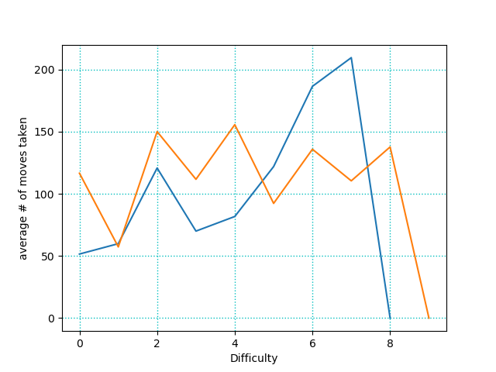
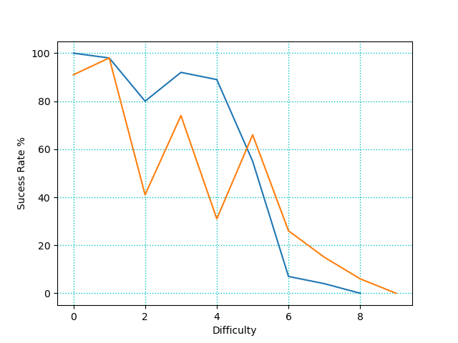
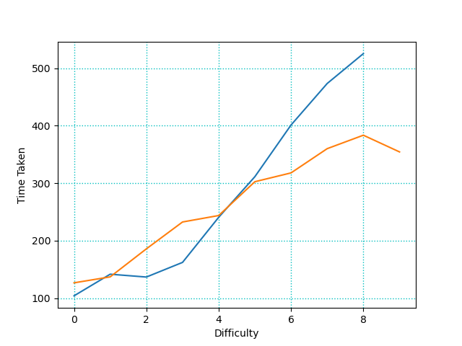
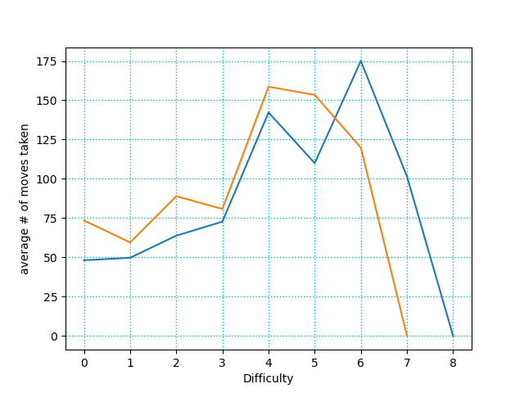
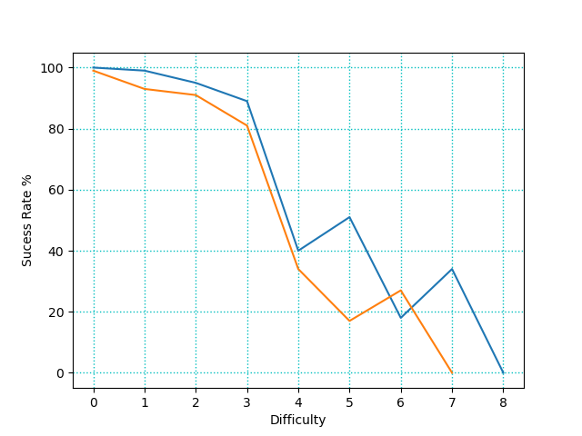
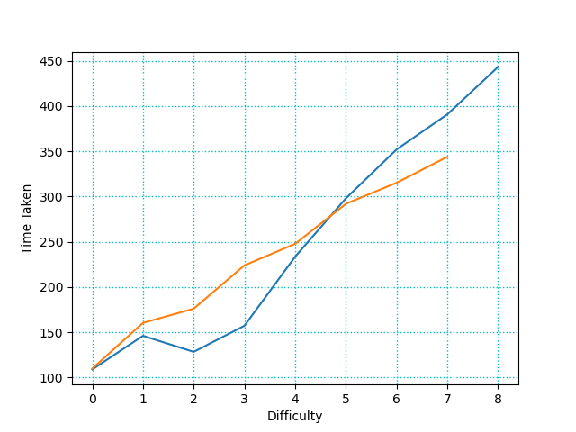
Results(Metrics)
Moves taken:
Success Rate:
Time Taken:
Experiment 1:
Experiment 3:

Slide 13
Results(Conclusions)
The experiment was run 5 times to get more accurate results.
Can effectively complete mazes until difficulty level 5 (15% walls)
Results that we expected:
# of moves taken correlated to difficulty
Success rate correlated to difficulty
The more complex network completed the maze in fewer moves
Some surprising results:
The simple network tends to reach a slightly higher difficulty.
Time taken was much shorter for the complex network at lower difficulties but much longer at higher difficulties as compared to the simple network
Time taken was surprisingly consistent between all experiments

Slide 14
Interesting Observations
By observing how the Neural network moved during and after it’s training I made some interesting observations.
Similar to people being left or right handed it will start favoring the top or bottom half of the maze
Starts to favor large open spaces.

Slide 15

Video

Slide 16
Questions???

